Slide 1

FOOD DELIVERY BOT USING D* Algorithm
Name : Hariharan.R & Harjith.R.S
Reg No.:128179012 & 128179017
Course : Introduction to AI(EIE115R01)

Slide 2
INTRODUCTION
With the increasing demands for automation in service industries, robotic systems are being widely used to improve efficiency and reduce human intervention. One such application is automated food delivery in environments such as restaurants, hospitals and campuses. Usual delivery methods rely heavily on human labour, which reduces efficiency, increases delays, increases operational costs, and puts human contact with food products at risk of spreading contagious diseases.
One of the main challenges in mobile robotics is path planning in dynamic environments. To resolve this challenge, our system uses the D* Lite algorithm, which enables real-time replanning of the path when obstacles are detected. Another important sphere in food delivery is safe delivery. This project integrates QR code-based verification using OpenCV, ensuring that only the intended customer can access the delivered item. The robot combines multiple subsystems, including navigation, obstacle detection, customer verification and communication, to deliver a complete autonomous solution.

Slide 3
Problem Statement
Delivering product without human intervention efficiently has become a big challenge in places where human contact with the product could lead to contamination and using human resources for such minimal tasks is not efficient in a known environment. To resolve all these needs an automated system can ensure reliable, efficient and error-free product delivery.
Objective of the Project
The main objective of the project is to build an automated robot system for food delivery in a known environment. The robot posses the ability to reach the desired destination efficiently by replanning its path when interfered by any dynamic obstacle using D* Lite algorithm. The robot must also authenticate its user using OpenCV pipelines.

Slide 4
D* LITE Algorithm
The D* Lite algorithm is used for efficient pathfinding in dynamic environments. It allows the robot to recalculate its path with respect to the goal when obstacles are detected, making it highly suitable for real-time navigation. The main advantage of D* Lite algorithm over A* algorithm is that D* Lite algorithm always recalculates its path from the current position to the goal position unlike A* algorithm which always recalculates the path from the start node which increases computation load un-necessarily. This makes D* algorithm highly efficient for dynamic obstacles.

Slide 5
D* LITE Algorithm Mechanism
This algorithm maintains two values for each node.
[s-current node ; s’-Next node]
g(s) : Heuristic value
c(s,s’) : This value states the transition value to move from one node to the next node.
rhs(s) : (Right-hand step value) It notes the g-value of the neighbor and determines which node to move to maintain a minimal step value.
FORMULA :-
rhs(s,s’) = g(s) + min [c(s,s’)]

Slide 6
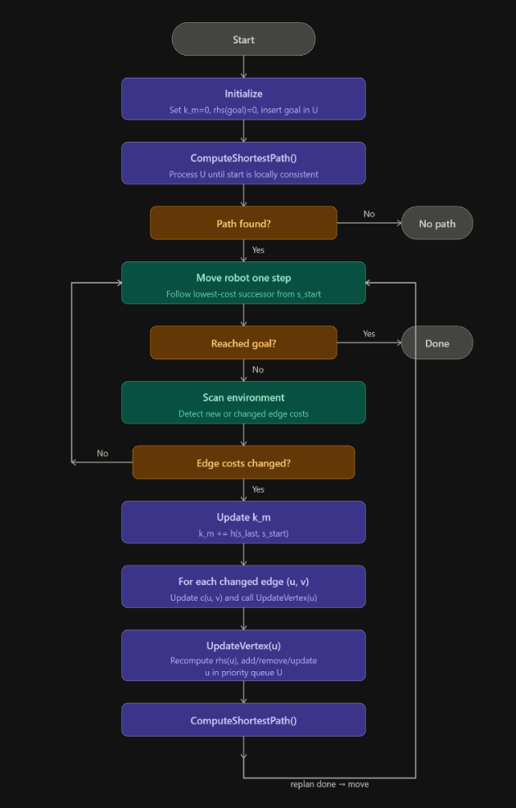

Slide 7
Obstacles Detection
Ultrasonic (US) sensors are used to detect obstacles in the robot’s path. When an obstacle is detected, the robot updates its path using the D* Lite algorithm. We have used HC-SR04 ultrasonic sensor.
Ultrasonic sensor emits a sound wave of high frequency(over 20kHz), this sound wave propagates in air medium and when comes in contact with an object gets reflected and propagates back to the sensor. This reflected wave is sensed by the sensor and the time difference taken between by the wave to start and come back to the sensor is calculated. This data is used to calculate the distance between the bot and the obstacle.
FORMULA :-
Distance = 343 * Time taken by the wave(In seconds)

Slide 8
QR Code Authentication using OpenCV
The robot uses a camera module integrated with OpenCV pipelines to detect and decode QR codes. It does the following:-
1.Captures image
2.Processes using OpenCV
3.Extracts QR data
4.Matches with stored data
If the QR code is valid, the bot confirms the customer.

Slide 9
OpenCV Working Mechanism
The QR code is initially captured and then image processing is initialized. The captured image of the QR code is stored in the form of a matrix. This matrix data is processed. Initially the white and black margins at the corner of the QR code is verified to detect the orientation of the QR code. Then the internal minor white and black lines are verified to check the surface type(Curved or straight) of the QR code. Once the mapping of the QR code has been successfully done the captured image is converted into a binary representation(Black squares = 1, White squares = 0). This Binarization and Normalization process produces a unique ID which is displayed.

Slide 10
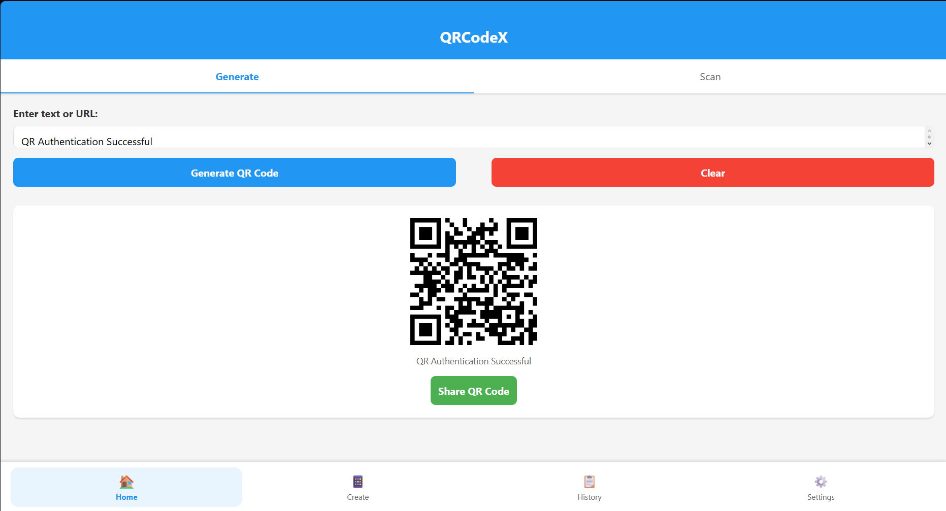
QR Code Graphical User
Interface

Slide 11
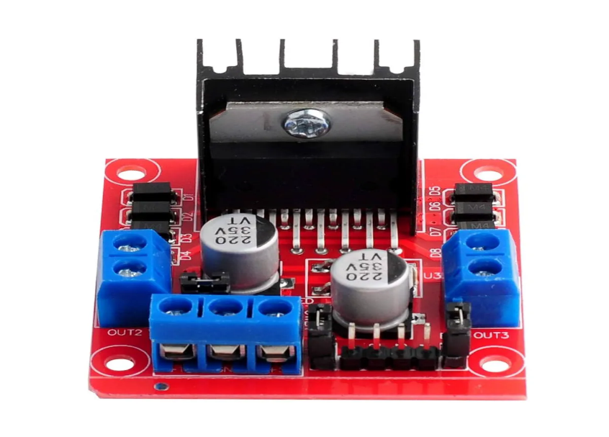
Hardware
Motor Driver
The directions of the robot are being controlled by differential drive method. To control the motors, we have used L298N Dual H-bridge Motor Driver module.

Slide 12
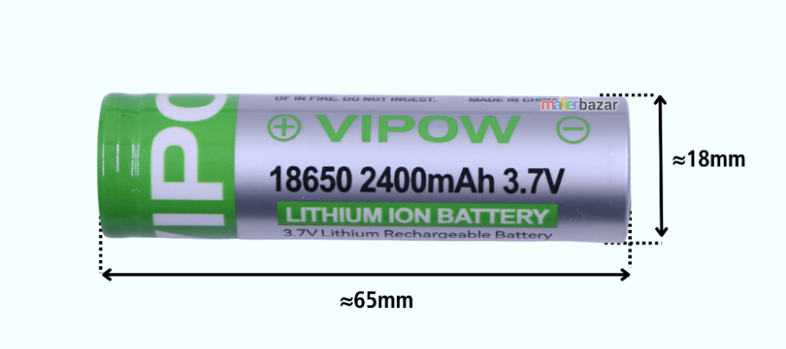
Battery
We used 4 Lithium-ion rechargeable battery of 3.7V each to aggregate a net voltage of 12V.

Slide 13
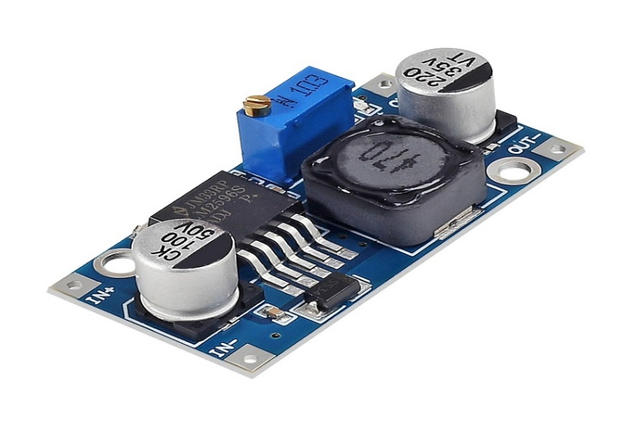
DC Buck Driver
We used a LM2596 DC-DC Buck driver to step down the higher input voltage to a save limit of 12V.

Slide 14
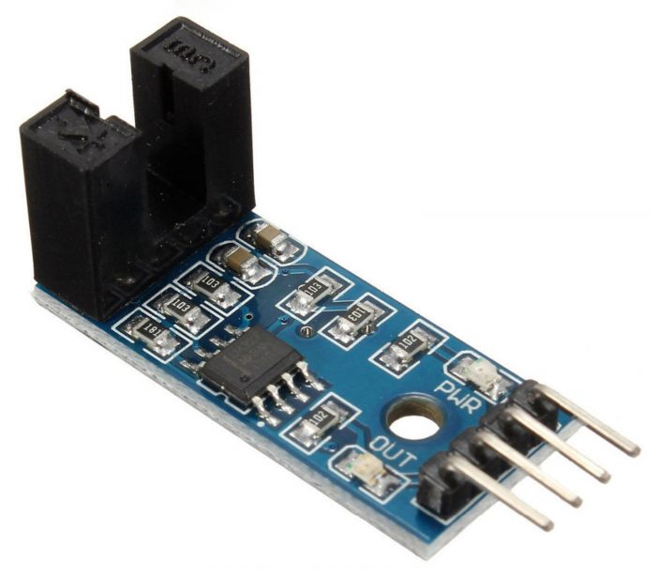
Wheel Rotation Measurement
A speed sensor LM393 is used to measure wheel rotation speed, which helps in :-
Distance calculation
Speed monitoring
Accurate navigation

Slide 15
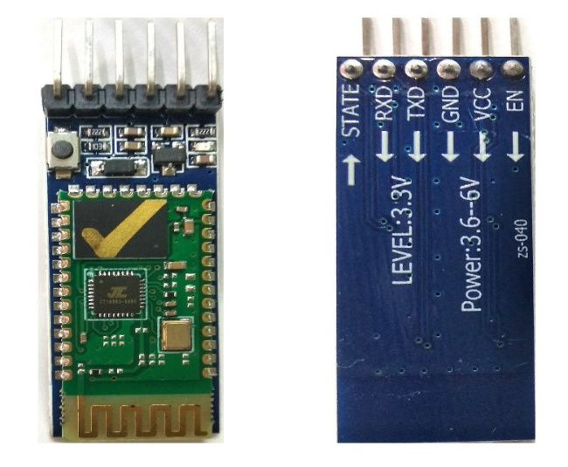
Communication System
Bluetooth module enables:
Wireless code upload
Command transmission
Real-time monitoring
Bluetooth Module

Slide 16
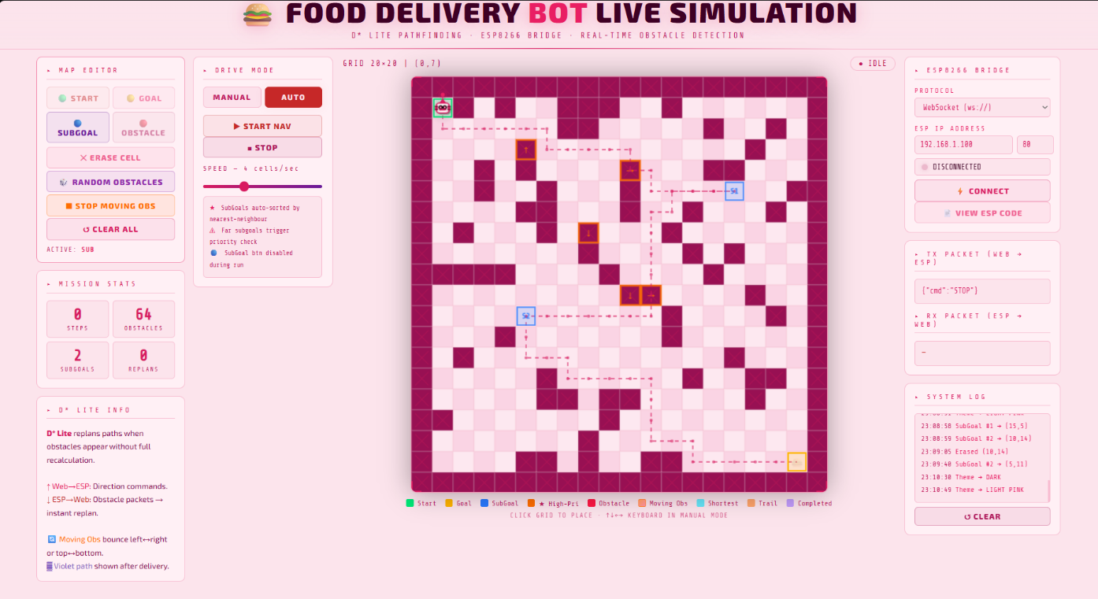
SIMULATION

Slide 17
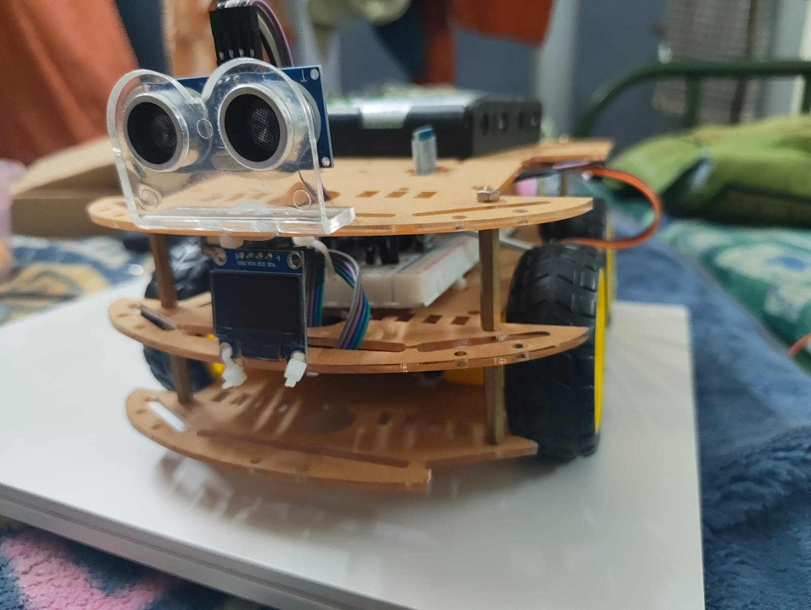
ROBOT IMAGE

Slide 18
FUTURE UPGRADES
The project achieves its objective of developing a smart, autonomous delivery system that reduces human effort, improves efficiency, and supports hygienic service operations.
The robot can be made smarter by adding AI and Machine Learning, so it can learn from its environment and make better decisions while navigating.
It can be upgraded to work in completely new places by using SLAM, allowing it to create maps and move without predefined paths.
Instead of basic ultrasonic sensors, more advanced technologies like LiDAR and depth cameras can be used to improve obstacle detection and accuracy.
The security system can be strengthened by adding facial recognition along with QR verification using OpenCV, making delivery safer.
By integrating with cloud systems, all robot data can be stored and analysed to improve performance over time.

Slide 19
CONCLUSION
The food delivery bot is an initial idea for implementing our basic knowledge about AI and robotics. This robot can be used to explore unknown environments in the future, it can be used to deliver products to places which cannot be reached by humans. We have successfully achieved our first goal by updating and implementing the knowledge we gained from our teachers, and we are still working in the process of upgrading ourselves.

Slide 20
THANK YOU

